Slide 1
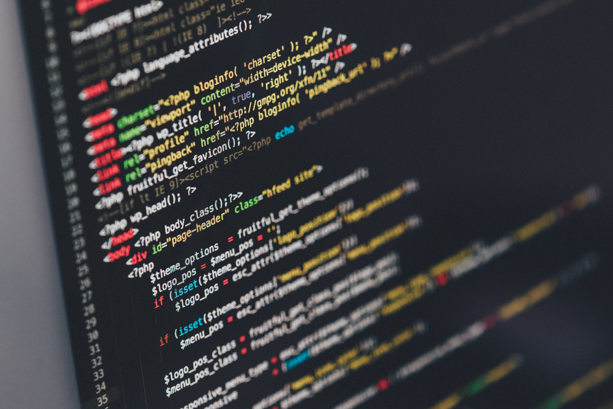
Fullstack Project Submission
Pavithra K Ganesan

Slide 2
Objective
Learn by doing: To get hands on experience in Full Stack Technology
Technologies used:
Springboot
Java 8
Postgre
JPA framework (Hibernate)
Angular 7
Node
Mongo
Express
Version Control Tool: Git
Build Tool: Maven and Jerkin
Application: To create a maker- checker application which can be used in multiple scenarios
Makers create their own account by registering with the required details
Requests are either accepted/ rejected by the maker

Slide 3
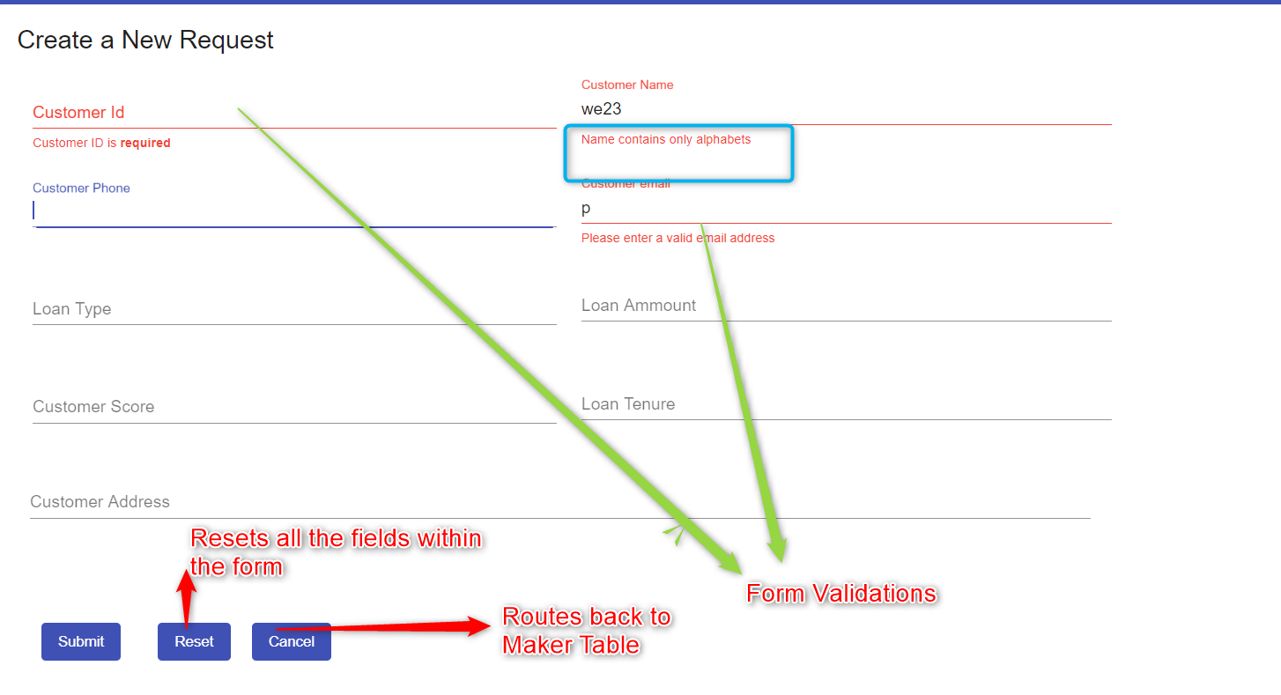
Screenshots
Create Table

Slide 4
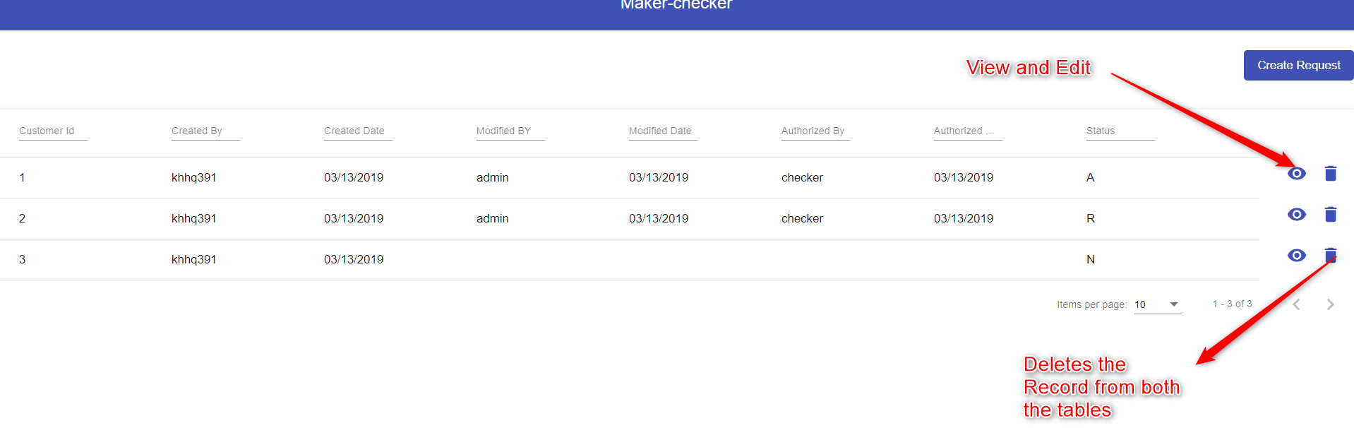
Screenshots
Maker Table

Slide 5
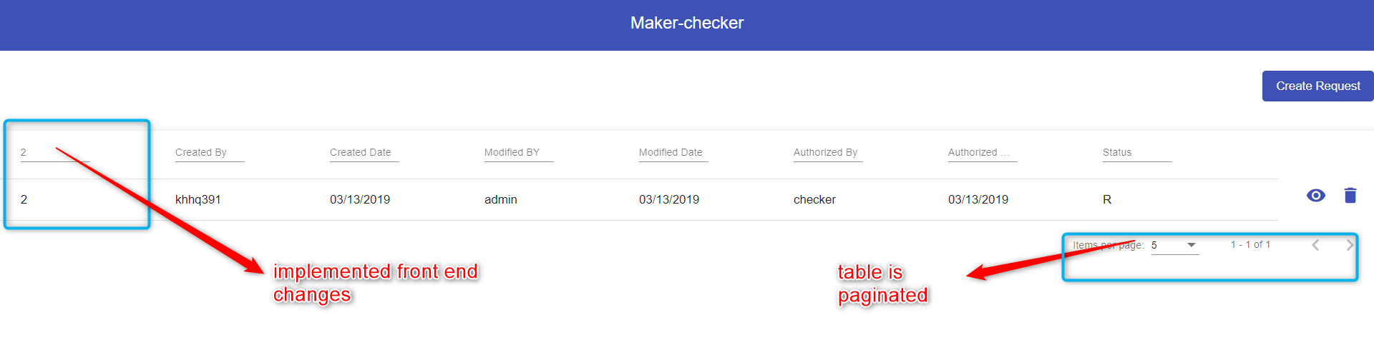
Screenshots
Maker Search

Slide 6
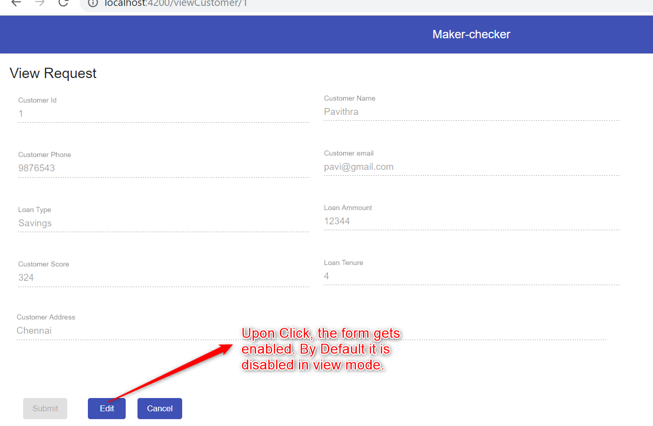
Screenshots
Form Editable

Slide 7
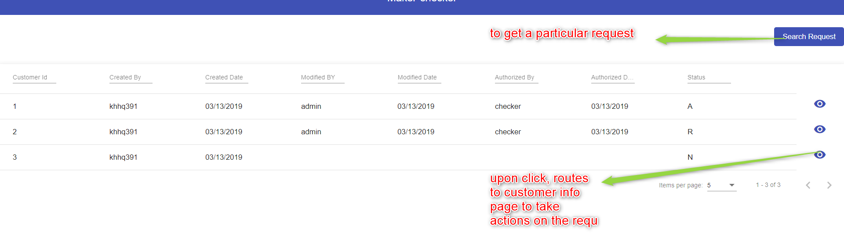
Screenshots
Checker Table

Slide 8
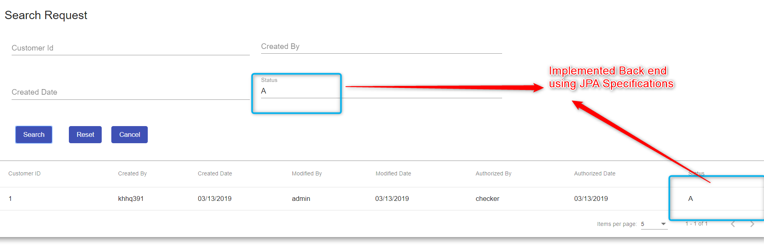
Screenshots
Checker Search

Slide 9
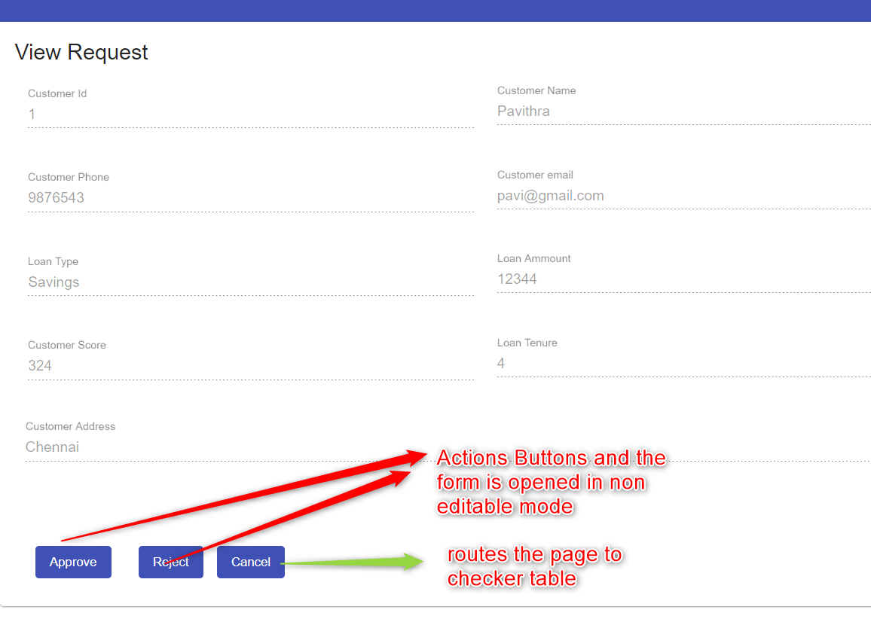
Screenshots
Checker Actions

Slide 10
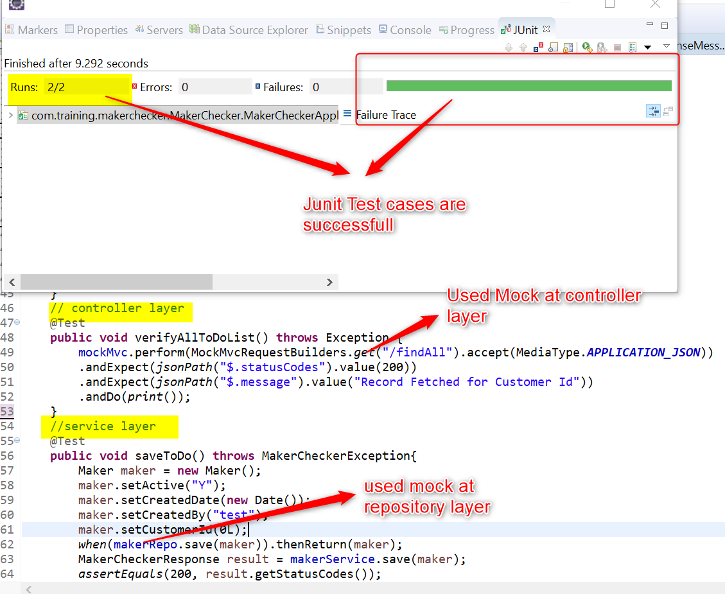
Screenshots
Junit Testcase

Slide 11
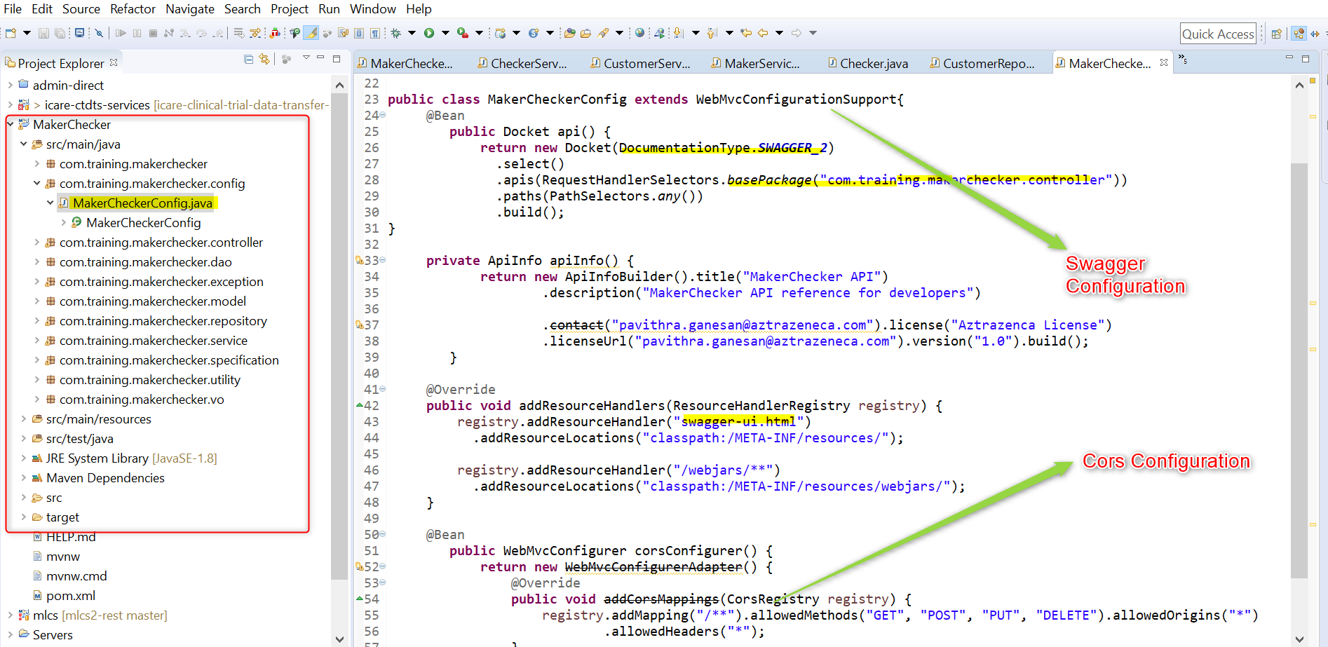
Code Snippets
Swagger & Cors Configuration

Slide 12
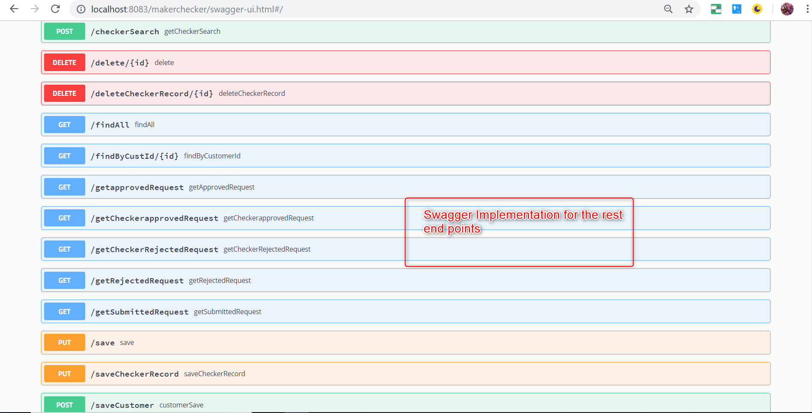
Code Snippets
Swagger UI

Slide 13
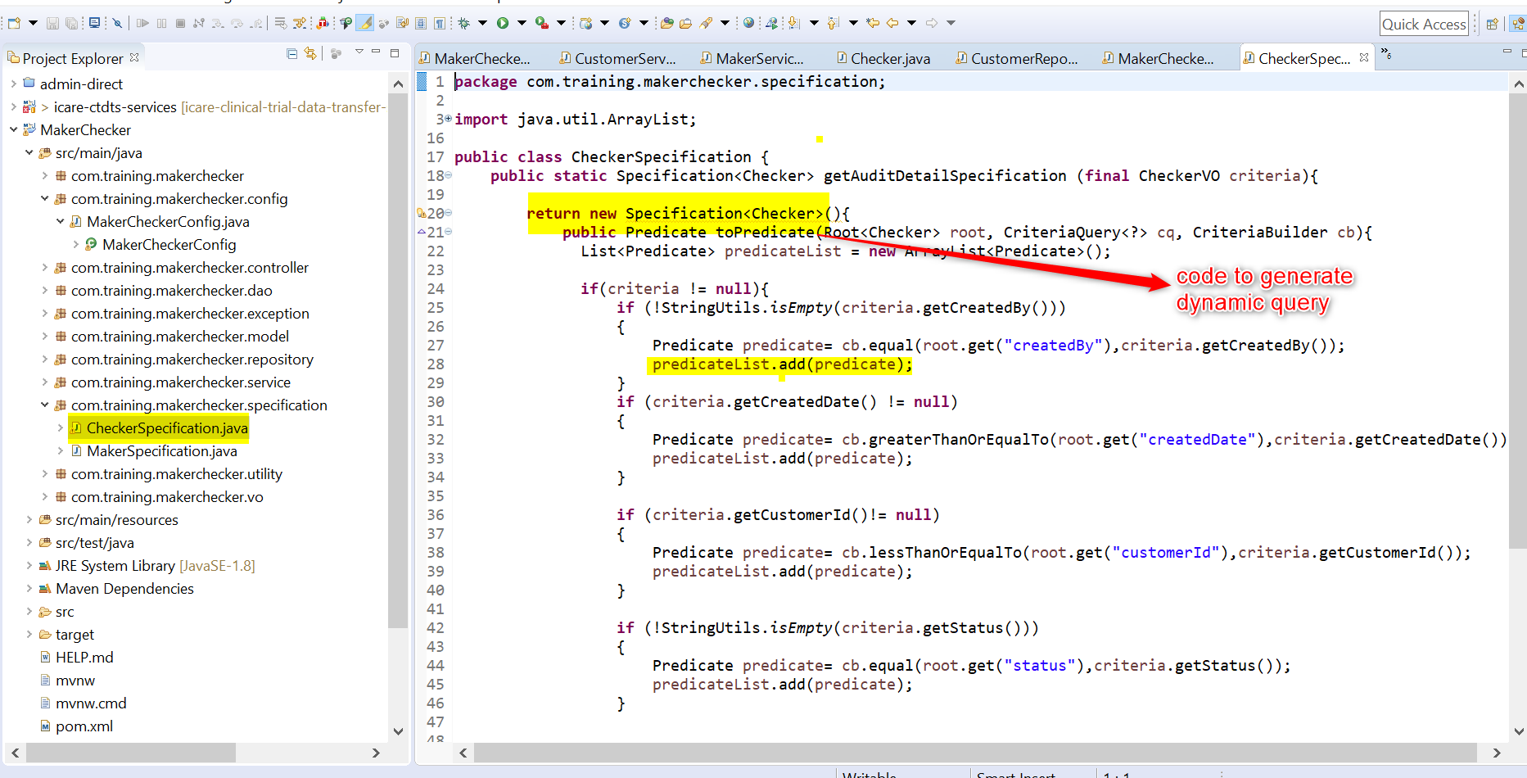
Code Snippets
JPA Specification

Slide 14
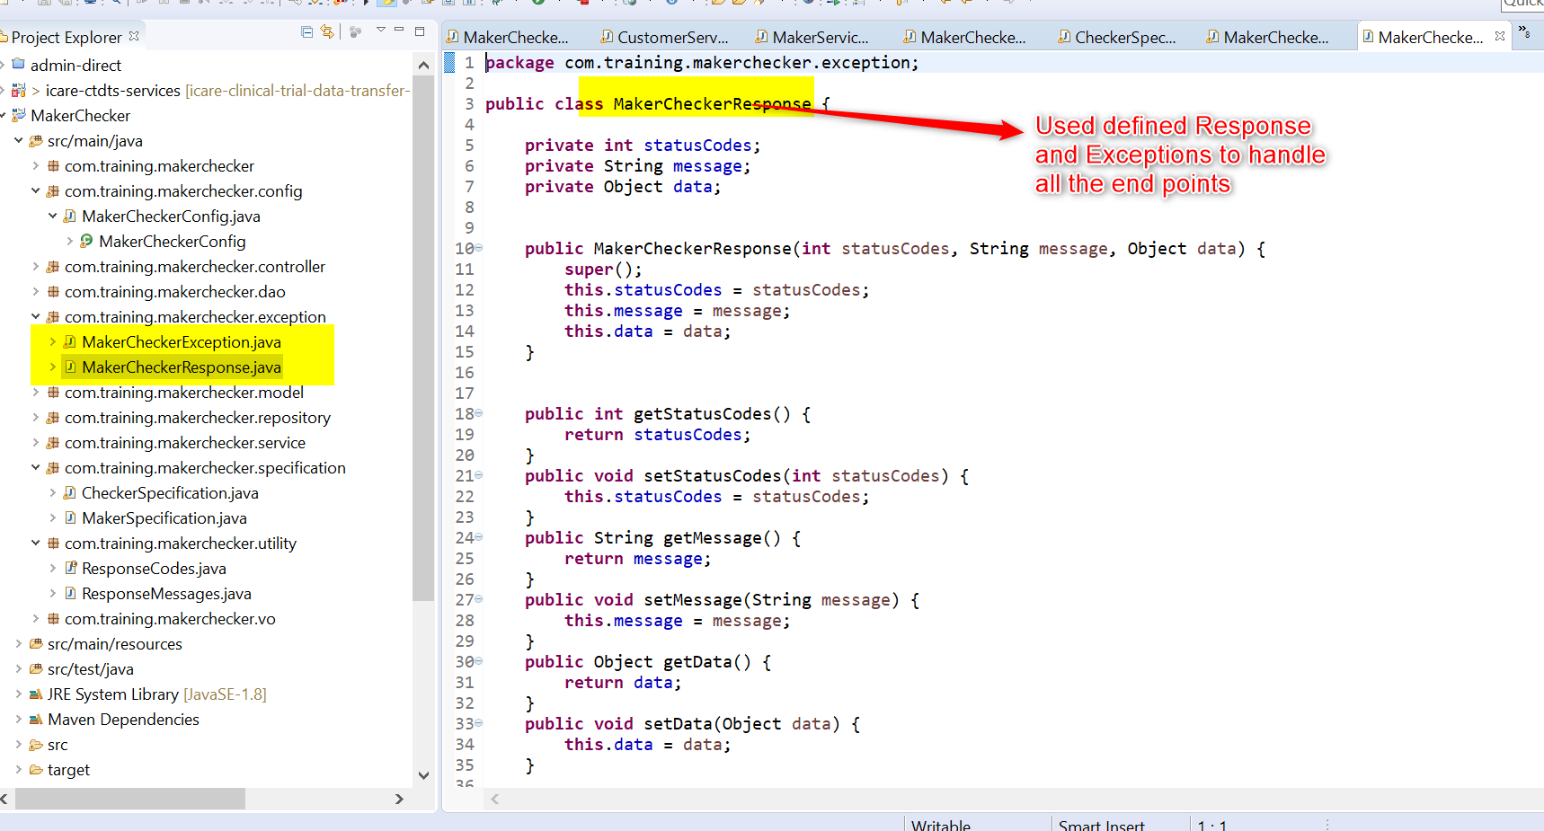
Code Snippets
User Defined Exceptions

Slide 15
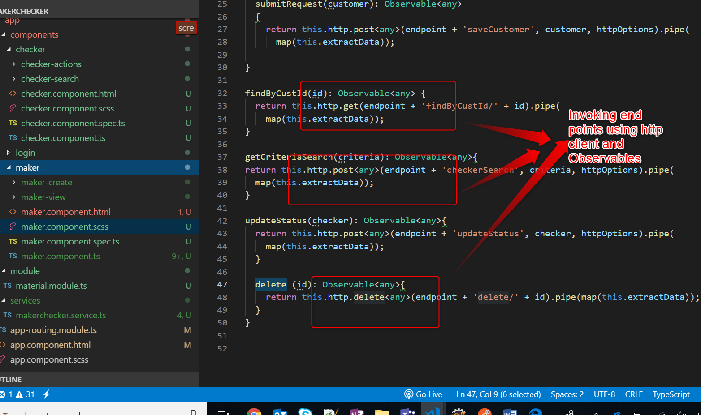
Code Snippets
Rest Endpoints

Slide 16
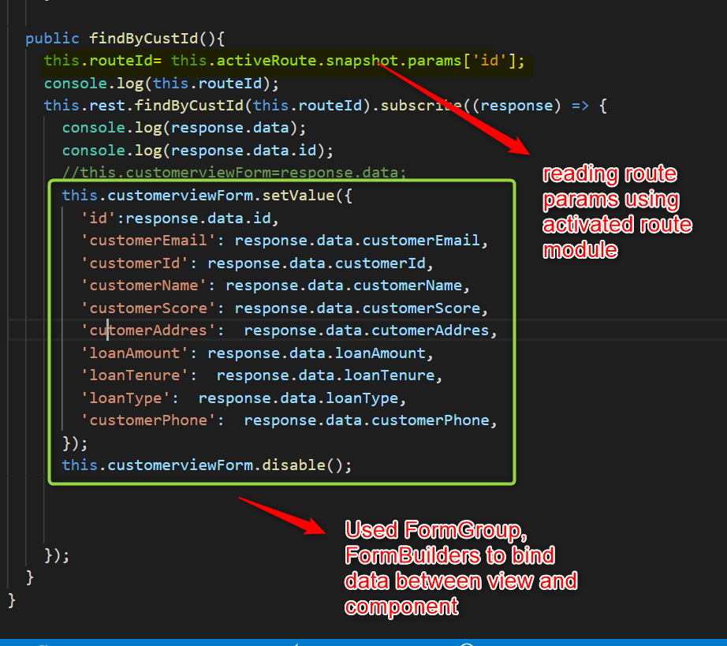
Code Snippets
Route Params

Slide 17
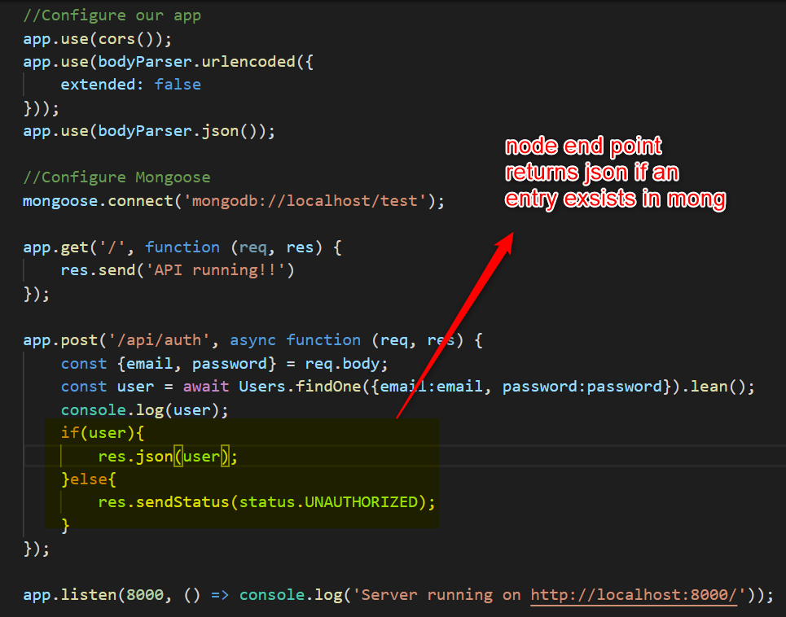
Code Snippets
Node Endpoint

Slide 18
Buglist
Angular table customisation is not working properly
Metadatasource module is not working as expected

Slide 19
Learnings
1
Angular Material Framework (most of the modules and validations)
2
Node
3
Mongo

Slide 20
